Slide 1
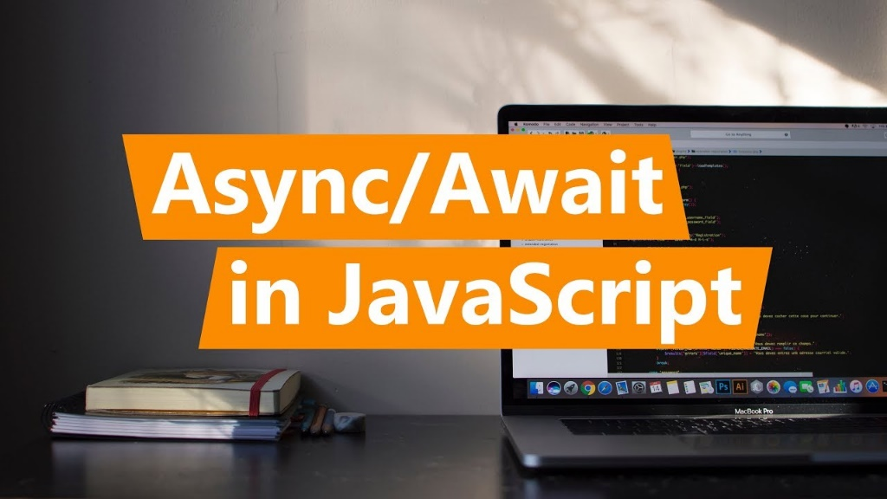
Asynchronous Programming and Promises
Promises. Async / Await
SoftUni Team
Technical Trainers
Software University
http://softuni.bg

Slide 2

Table of Contents
Asynchronous Programming
Promises in JS – Concepts
Promises with AJAX
Using Async / Await

Slide 3
Have a Question?
sli.do #JSCORE

Slide 4
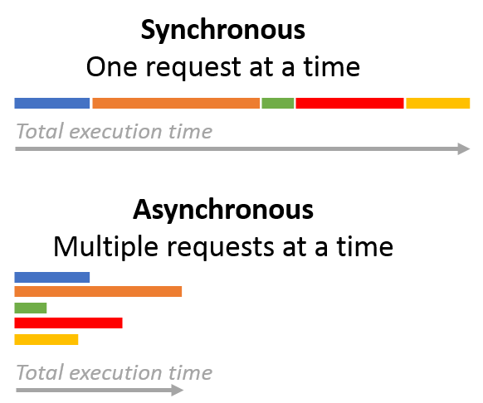
Asynchronous Programming

Slide 5
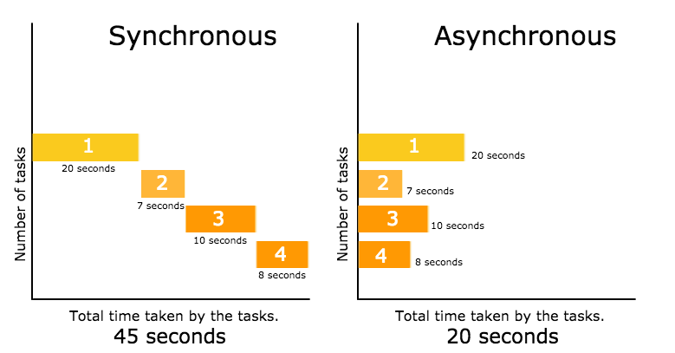
Asynchronous Programming
Asynchronous programming deals with the needs to run several tasks (pieces of code) in parallel, in the same time

Slide 6
Asynchronous Programming
Synchronous programming
Each line of code is executed only when the preceding line has finished it’s work
Asynchronous Programming
In asynchronous programs, you can have two lines of code (L1 followed by L2), where L1 schedules some task to be run in the future, but L2 runs before that task completes
The tasks may finish in order of execution but it is not guaranteed

Slide 7
Asynchronous Programming – Example
// Say "Hello."
console.log("Hello.");
// Say "Goodbye" two seconds from now.
setTimeout(function() {
console.log("Goodbye!");
}, 2000);
// Say "Hello again!"
console.log("Hello again!");
function getData() {
var data;
$.get("example.php", function(response) {
data = response;
}
);
return data;
}
var data = getData();
console.log("The data is: " + data);
What is wrong with these examples?

Slide 8
Asynchronous Programming in JS
Asynchronous does not mean the same thing as concurrent or multi-threaded
JavaScript can have asynchronous code, but it is generally single-threaded (except when using Web Workers)
Asynchronous code needs to be structured in a different way than synchronous code, and the most basic way to do that is with callback functions
In current versions of JavaScript we have two more options
Promises
Async / Await patern

Slide 9
Do we need asynchronous programming in JS?
Some people decide that dealing with asynchronous code is too complicated to work with, so they try to make everything synchronous
When doing an AJAX call, it is possible to set an option to make the call synchronous rather than asynchronous (although this option is slowly losing browser support)
There are also synchronous alternatives to many asynchronous functions in Node.js

Slide 10
Do we need asynchronous programming in JS?
Trying to avoid asynchronous code and replacing it with synchronous code is almost always a bad idea in JavaScript
JavaScript only has a single thread (except when using Web Workers)
The webpage will be unresponsive while the script is running. If you use a synchronous AJAX call, then the user will not be able to do anything while they are running
The issue is even worse when using server-side JavaScript: the server will not be able to respond to any requests while waiting for synchronous functions to complete, which means that every user making a request to the server will have to wait to get a response

Slide 11

Promises
.then()
.catch()
Promises in JS
Objects Holding Asynchronous Operations

Slide 12
What is a Promise?
A promise is an object holding an asynchronous operation
A result which may be available now, or in the future, or never
Promises let asynchronous methods return values like synchronous methods, instead of immediately returning the final value, the asynchronous method returns a promise to supply the value at some point in the future
Promises may be in one of these states:
Pending – operation still running (unfinished)
Fulfilled – operation finished (and the result is available)
Failed – operation is failed (and an error is available)
Promises in JS use the Promise object

Slide 13
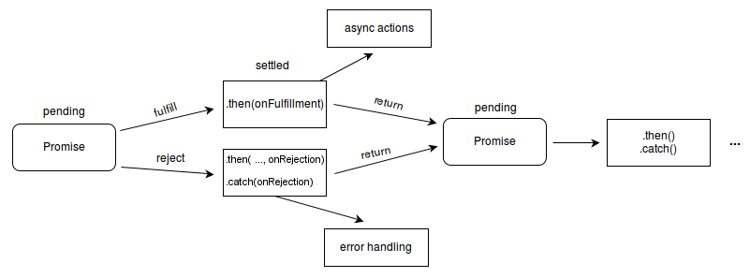
What is a Promise?

Slide 14
Promise Methods
Promise.all(iterable)
Returns a promise that either fulfills when all of the promises in the iterable argument have fulfilled or rejects as soon as one of the promises in the iterable argument rejects
fulfilled with an array of the values from the fulfilled promises in the same order as defined in the iterable
rejected with the reason from the first promise in the iterable that rejected

Slide 15
Promise Methods
Promise.race(iterable)
Returns a promise that fulfills or rejects as soon as one of the promises in the iterable fulfills or rejects, with the value or reason from that promise
Promise.reject(reason)
Returns a Promise object that is rejected with the given reason
Promise.resolve(value)
Returns a Promise object that is resolved with the given value

Slide 16
JS Promises – Syntax
let p = new Promise(function(resolve, reject) {
// Do an async task and then resolve or reject
if (/* operation successful */)
resolve('Success!');
else /* operation failed */
reject('Failure!');
});
p.then(function(result) {
/* process the result (when the promise is resolved) */ })
.catch(function(error) {
/* handle the error (when the promise is rejected) */ });

Slide 17
Promise.then() – Example
console.log('Before promise');
new Promise(function(resolve, reject) {
setTimeout(function() {
resolve('done');
}, 500);
})
.then(function(result) {
console.log('Then returned: ' + result);
});
console.log('After promise');
Before promise
After promise
Then returned: done
Resolved after 500 ms
Check your solution here: https://judge.softuni.bg/Contests/360

Slide 18
Promise.catch() – Example
console.log('Before promise');
new Promise(function(resolve, reject) {
setTimeout(function() {
reject('fail');
}, 500);
})
.then(function(result) { console.log(result); })
.catch(function(error) { console.log(error); });
console.log('After promise');
Before promise
After promise
fail
Rejected after 500 ms
Check your solution here: https://judge.softuni.bg/Contests/360

Slide 19
Asynchronous function with Promise – Example
function getAsync(url)
{
return new Promise((resolve, reject) =>
{
const xhr = new XMLHttpRequest();
xhr.open("GET", url);
xhr.onload = () => resolve(xhr.responseText);
xhr.onerror = () => reject(xhr.statusText);
xhr.send();
});
}

Slide 20
JS Promises – Example – First Task
let p1 = new Promise(
function(resolve, reject) {
console.log("task1 started.");
setTimeout(function() {
resolve("task1 result");
console.log("task1 finished.");
}, 1000);
}
);

Slide 21
JS Promises – Example – Second Task
let p2 = new Promise(
function(resolve, reject) {
console.log("task2 started.");
setTimeout(function() {
resolve("task2 result");
console.log("task2 finished.");
}, 1500);
}
);

Slide 22
JS Promises – Example – Third Task
let p3 = new Promise(
function(resolve, reject) {
console.log("task3 started.");
// reject('cannot execute task3');
setTimeout(function() {
resolve("task3 result");
console.log("task3 finished.");
}, 500);
}
);

Slide 23
JS Promises – Example – Execution
console.log("All tasks started.");
Promise.all([p1, p2, p3])
.then(function(result) {
console.log("All tasks finished.");
console.log("Result: " + result.join(", "));
// nonExistingFunction();
})
.catch(function(error) {
console.log("Some of the tasks failed.");
console.log("Error: " + error);
});
Error in then() block will reject the promise
Check your solution here: https://judge.softuni.bg/Contests/360

Slide 24

Promises with jQuery AJAX

Slide 25
jQuery Promise
The Deferred object, introduced in jQuery 1.5, is a chainable utility object created by calling the jQuery.Deferred() method. It can register multiple callbacks into callback queues, invoke callback queues, and relay the success or failure state of any synchronous or asynchronous function
jQuery 3.0 and newer Deferred object is a Promises/A+ implementation
Deferred object is thanable, so can be casted to native JS Promise, but some of the arguments passed to than() method will be discarded

Slide 26
jQuery Promise interface
As of jQuery 1.5, all of jQuery's Ajax methods return a superset of the XMLHTTPRequest object. This jQuery XHR object, or "jqXHR“, implements the Promise interface.
jqXHR.done(function( data, textStatus, jqXHR ) {});
An alternative construct to the success callback option
jqXHR.fail(function( jqXHR, textStatus, errorThrown ) {});
An alternative construct to the error callback option, the .fail() method replaces the deprecated .error() method
jqXHR.always(function( data|jqXHR, textStatus, jqXHR|errorThrown ) { }); (added in jQuery 1.6)
An alternative construct to the complete callback option, the .always() method replaces the deprecated .complete() method.
In response to a successful request, the function's arguments are the same as those of .done(): data, textStatus, and the jqXHR object For failed requests the arguments are the same as those of .fail(): the jqXHR object, textStatus, and errorThrown
jqXHR.then(function( data, textStatus, jqXHR ) {}, function( jqXHR, textStatus, errorThrown ) {});
Incorporates the functionality of the .done() and .fail() methods, allowing (as of jQuery 1.8) the underlying Promise to be manipulated

Slide 27
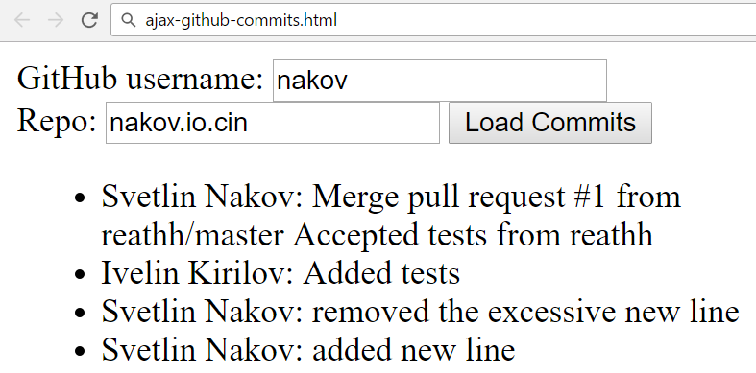
Problem: Load GitHub Commits with AJAX
GitHub username:
<input type="text" id="username" value="nakov" /> <br>
Repo: <input type="text" id="repo" value="nakov.io.cin" />
<button onclick="loadCommits()">Load Commits</button>
<ul id="commits"></ul>
<script>
function loadCommits() {
// AJAX call …
}
</script>

Slide 28
Solution: Load GitHub Commits with AJAX
function loadCommits() {
$("#commits").empty();
let url = "https://api.github.com/repos/" +
$("#username").val() + "/" +
$("#repo").val() + "/commits";
$.get(url)
.then(displayCommits)
.catch(displayError);
function displayCommits(commits) { … }
function displayError(err) { … }
}
jQuery AJAX methods return promises

Slide 29
Solution: Load GitHub Commits with AJAX (2)
function displayCommits(commits) {
for (let commit of commits)
$("#commits").append($("<li>").text(
commit.commit.author.name + ": " +
commit.commit.message
));
}
function displayError(err) {
$("#commits").append($("<li>").text("Error: " +
err.status + ' (' + err.statusText + ')'));
}
Check your solution here: https://judge.softuni.bg/Contests/360

Slide 30
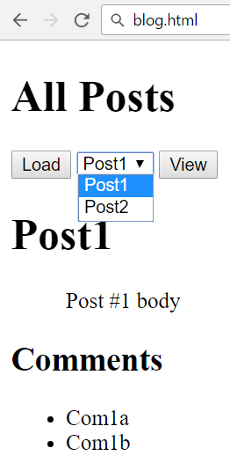
Problem: Blog (Posts with Comments)
Create a Kinvey app
Create user "peter" with password "p"
Create posts "Post1" and "Post2"
Create comments "Com1a" and "Com1b"
for "Post1"
Create comments "Com2a", "Com2b" and
"Com2c" for "Post2"
Write a JS app to display all posts and view
selected post along with its comments

Slide 31
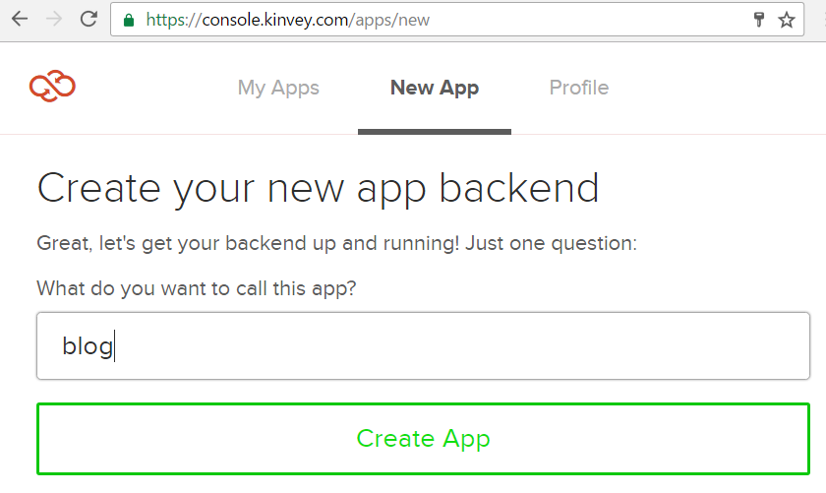
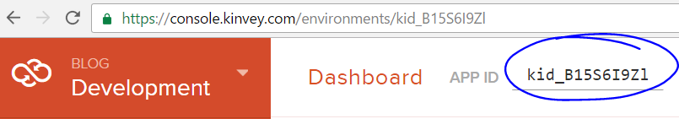
Solution: Blog – Create a Kinvey App
Remember your app ID

Slide 32
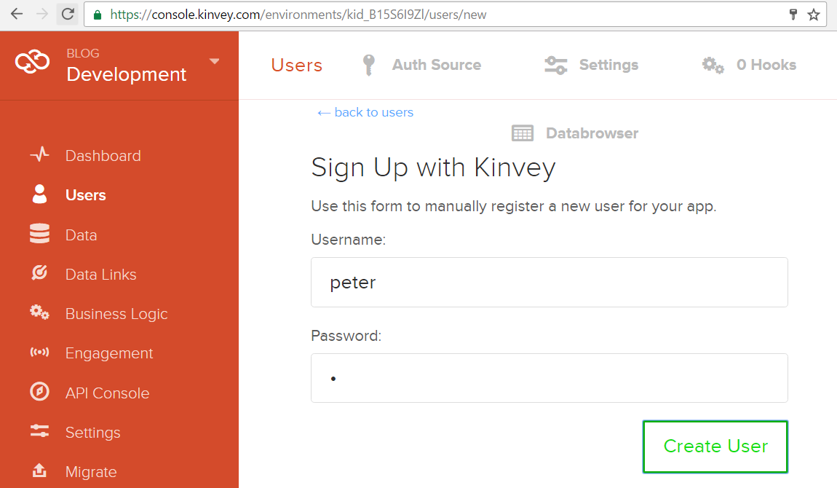
Solution: Blog – Create User "peter"

Slide 33
Solution: Blog – Create the First Post
Insert your Kinvey App ID here
POST /appdata/kid_B15S6I9Zl/posts/ HTTP/1.1
Host: baas.kinvey.com
Authorization: Basic Z3Vlc3Q6Z3Vlc3Q=
Content-Type: application/json
{ "title":"Post1", "body":"Post #1 body" }
Base64(user:pass)
{ "title": "Post1", "body": "Post #1 body", …,
"_id": "582cde77209db9d9730bab03" }
Remember the post _id

Slide 34
Solution: Blog – Create the Comments
POST /appdata/kid_B15S6I9Zl/comments/ HTTP/1.1
Host: baas.kinvey.com
Authorization: Basic Z3Vlc3Q6Z3Vlc3Q=
Content-Type: application/json
{ "text":"Com1a", "post_id":"582cde77209db9d9730bab03" }
Use post _id from the previous request
POST /appdata/kid_B15S6I9Zl/comments/ HTTP/1.1
Host: baas.kinvey.com
Authorization: Basic Z3Vlc3Q6Z3Vlc3Q=
Content-Type: application/json
{ "text":"Com2a", "post_id":"582cde77209db9d9730bab03" }

Slide 35
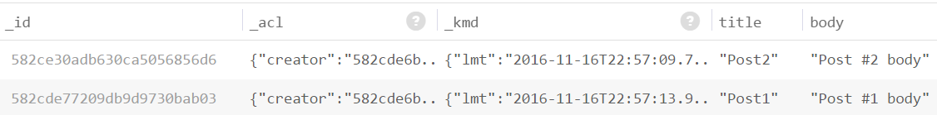
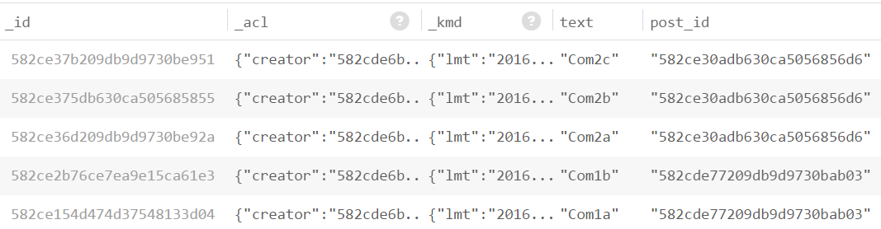
Solution: Blog – Create the Second Post
Create the second post "Post2" + its 3 comments
The "posts" and "comments" collections should look like these:

Slide 36
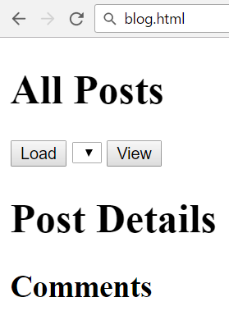
Solution: Blog – HTML Code
<script src="jquery-3.1.1.min.js"></script>
<script src="blog.js"></script>
<h1>All Posts</h1>
<button id="btnLoadPosts">Load</button>
<select id="posts"></select>
<button id="btnViewPost">View</button>
<h1 id="post-title">Post Details</h1>
<ul id="post-body"></ul>
<h2>Comments</h2>
<ul id="post-comments"></ul>

Slide 37
Solution: Blog – JS Code
$(document).ready(function() {
const kinveyAppId = "kid_B15S6I9Zl";
const serviceUrl = "https://baas.kinvey.com/appdata/" + kinveyAppId;
const kinveyUsername = "peter";
const kinveyPassword = "p";
const base64auth = btoa(kinveyUsername + ":" + kinveyPassword);
const authHeaders = { "Authorization": "Basic " + base64auth };
$("#btnLoadPosts").click(loadPostsClick);
$("#btnViewPost").click(viewPostClick);
function loadPostsClick() { … }
function viewPostClick() { … }
…
});

Slide 38
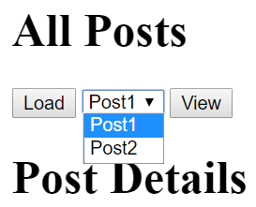
Solution: Blog – Load Posts
function loadPostsClick() {
let loadPostsRequest = {
url: serviceUrl + "/posts",
headers: authHeaders,
};
$.ajax(loadPostsRequest)
.then(displayPosts)
.catch(displayError);
}

Slide 39
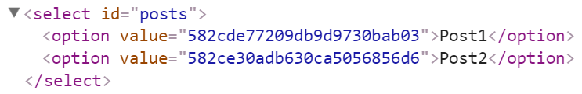
Solution: Blog – Display Posts as Options
function displayPosts(posts) {
$("#posts").empty();
for (let post of posts) {
let option = $("<option>")
.text(post.title)
.val(post._id);
$("#posts").append(option);
}
}

Slide 40
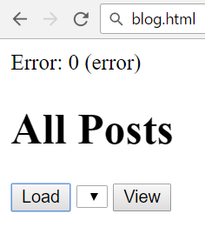
Solution: Blog – Handle AJAX Errors
function displayError(err) {
let errorDiv = $("<div>").text("Error: " +
err.status + ' (' + err.statusText + ')');
$(document.body).prepend(errorDiv);
setTimeout(function() {
$(errorDiv).fadeOut(function() {
$(errorDiv).remove();
});
}, 3000);
}

Slide 41
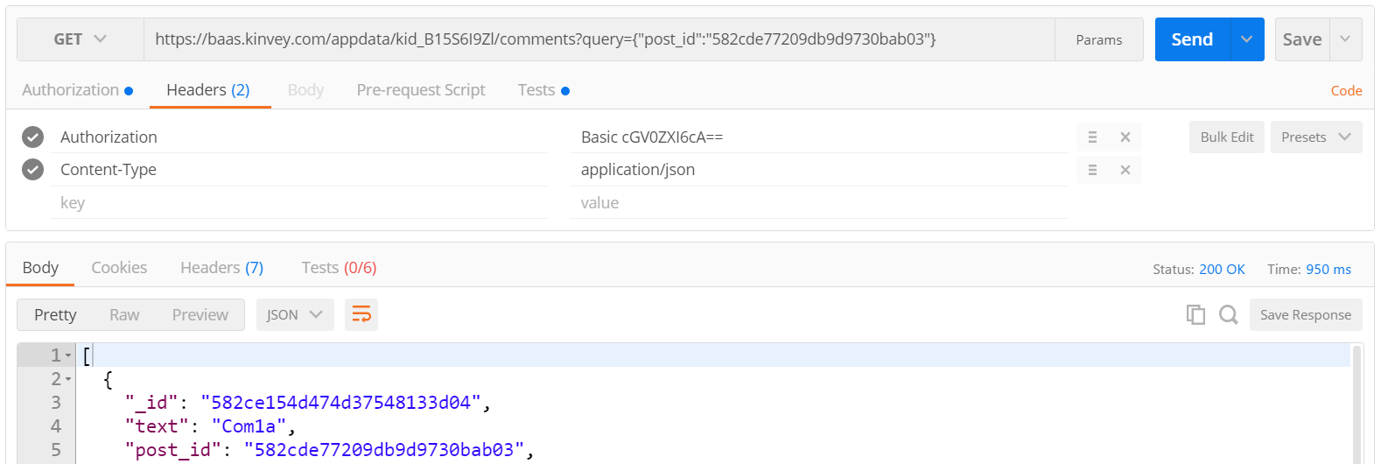
Solution: Blog – Load Post Comments Query
Kinvey allows querying collections:
https://baas.kinvey.com/appdata/kid_B15S6I9Zl/comments
?query={"post_id":"582cde77209db9d9730bab03"}

Slide 42
Solution: Blog – [View Post] Button Click
function viewPostClick() {
let selectedPostId = $("#posts").val();
if (!selectedPostId) return;
let requestPosts = $.ajax({
url: serviceUrl + "/posts/" + selectedPostId,
headers: authHeaders });
let requestComments = $.ajax({ url: serviceUrl + `/comments/?query={"post_id":"${selectedPostId}"}`,
headers: authHeaders });
Promise.all([requestPosts, requestComments])
.then(displayPostWithComments)
.catch(displayError);
}

Slide 43
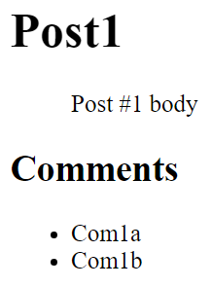
Solution: Blog – Display Post with Its Comments
function displayPostWithComments([post, comments]) {
$("#post-title").text(post.title);
$("#post-body").text(post.body);
$("#post-comments").empty();
for (let comment of comments) {
let commentItem = $("<li>")
.text(comment.text);
$("#post-comments")
.append(commentItem);
}
}
Check your solution here: https://judge.softuni.bg/Contests/360

Slide 44
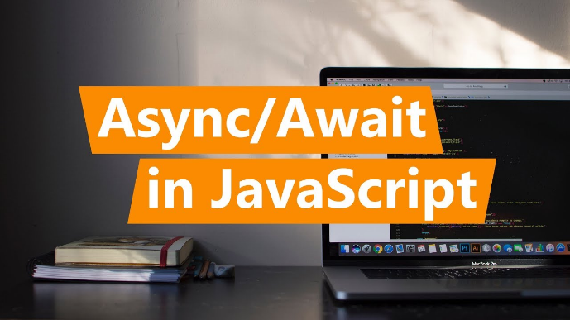
Async / Await
Simplified Promises

Slide 45
Async Functions
The async function declaration defines an asynchronous function, which returns an AsyncFunction object
An asynchronous function is a function which operates asynchronously via the event loop, using an implicit Promise to return its result
The syntax and structure of your code using async functions is much more like using standard synchronous functions

Slide 46
Async Functions
function resolveAfter2Seconds() {
return new Promise(resolve => {
setTimeout(() => {
resolve('resolved');
}, 2000);
});
}
async function asyncCall() {
console.log('calling');
var result = await resolveAfter2Seconds();
console.log(result);
// expected output: 'resolved'
}
asyncCall();

Slide 47
Async Functions
An async function can contain an await expression that pauses the execution and waits for the passed Promise's resolution
After resolution the async function's execution resumes and resolved value is available
Тhe await keyword is only valid inside async functions
The purpose of async/await functions is to simplify the behavior of using promises synchronously
async/await is similar to combining generators and promises

Slide 48
Async Functions
Do not confuse await for Promise.then()
If you wish to await two or more promises in parallel, you must still use Promise.then()
var resolveAfter2Seconds = function() {
console.log("starting slow promise");
return new Promise(resolve => {
setTimeout(function() {
resolve(20);
console.log("slow promise is done");
}, 2000);
});
};
var resolveAfter1Second = function() {
console.log("starting fast promise");
return new Promise(resolve => {
setTimeout(function() {
resolve(10);
console.log("fast promise is done");
}, 1000);
});
};

Slide 49
Sequential Start
Еxecution suspends 2 seconds for the first await, and then again another 1 second for the second await.
The second timer is not created until the first has already fired
var sequentialStart = async function() {
console.log('==SEQUENTIAL START==');
const slow = await resolveAfter2Seconds(); const fast = await resolveAfter1Second();
console.log(slow);
console.log(fast);
}

Slide 50
Concurrent Start
Both timers are created and then awaited. The timers are running concurrently but the await calls are still running in series, meaning the second await will wait for the first one to finish
This leads the code to finish in 2 rather than 3 seconds, which is the time the slowest timer needs
var concurrentStart = async function() {
console.log('==CONCURRENT START==');
const slow = resolveAfter2Seconds();
// starts timer immediately
const fast = resolveAfter1Second();
console.log(await slow);
console.log(await fast);
// waits for slow to finish, even though
fast is already done!
}
var stillConcurrent = function() {
console.log('==PROMISE ALL START==');
Promise.all([resolveAfter2Seconds(),
resolveAfter1Second()])
.then((messages) => {
console.log(messages[0]); // slow
console.log(messages[1]); // fast
});
}

Slide 51
Parallel Start
If you wish to await two or more promises in parallel, you must still use Promise.then()
var parallel = function() {
console.log('==PARALLEL with Promise.then==');
resolveAfter2Seconds().then((message)=>console.log(message));
resolveAfter1Second().then((message)=>console.log(message));
}

Slide 52
Error Handling
If a promise resolves normally, then await promise returns the result. But in case of a rejection, it throws the error, just as if there were a throw statement at that line
async function f() { try {
let response = await fetch();
let user = await response.json();
} catch (err) {
// catches errors both in fetch and
response.json
alert(err);
}
}
async function f() {
let response = await fetch();
}
// f() becomes a rejected promise
f().catch(alert);
52

Slide 53

Live Exercises in Class (Lab)
Practice: Promises, AJAX, Async / Await

Slide 54

Summary
…
…
…
Promises hold operations (background tasks)
Can be resolved or rejected
jQuery AJAX works with promises
p.then(function(result) {
/* process the result */ })
.catch(function(error) {
/* handle the error */ });
$.ajax(request)
.then(function(data) { … })
.catch(function(error) { … });

Slide 55
https://softuni.bg/trainings/2082/js-applications-november-2018

Slide 56













SoftUni Diamond Partners

Slide 57





SoftUni Organizational Partners

Slide 58




Trainings @ Software University (SoftUni)
Software University – High-Quality Education and Employment Opportunities
softuni.bg
Software University Foundation
http://softuni.foundation/
Software University @ Facebook
facebook.com/SoftwareUniversity
Software University Forums
forum.softuni.bg

Slide 59

License
This course (slides, examples, demos, videos, homework, etc.) is licensed under the "Creative Commons Attribution-NonCommercial-ShareAlike 4.0 International" license

